Slide 1


Oral Communication Skills A
(CELEN069)
Core Unit 2
Mental wellbeing at university
Lesson 4.1

Slide 2
Lesson aims and objectives
By the end of this lesson, you should have enhanced your speaking and listening ability through practice.
In addition, you should be better able to … | Intended Learning Outcomes
produce well organised and comprehensive notes for upcoming Listening Portfolio tasks | 1.1-1.6 2.7 3.1 3.3 3.5 4.1
recognise when a lecturer moves from one main point to another
use information from different sources to support ideas in a discussion

Slide 3
Listening Portfolio
Practice task feedback

Slide 4
Listening Portfolio: Basic requirements
1. Did you take notes on the right lecture?
Lecture 1B: Strategies for overcoming common issues
2. Did you submit your notes to Moodle as a .pdf file?
3. Did you submit your notes to the correct submission box on Moodle?
Week 3 section: Listening Portfolio - Practice Task (unassessed)
4. Did you submit your notes before the deadline (Friday, 18th October, 3pm)?
Please note:
The next three Listening Portfolio tasks are assessed. The issues above are common reasons why students have failed the tasks in previous years.

Slide 5
Listening Portfolio: Practice task feedback
Open the notes you took for Lecture 1B.
With a partner, look at each other’s notes and answer the questions below.
Do you think your notes are well organised?
Is it clear what the different sections are?
Have you included detail in each section to allow you to understand the ideas from that section?
What could you do to improve your notes?

Slide 6
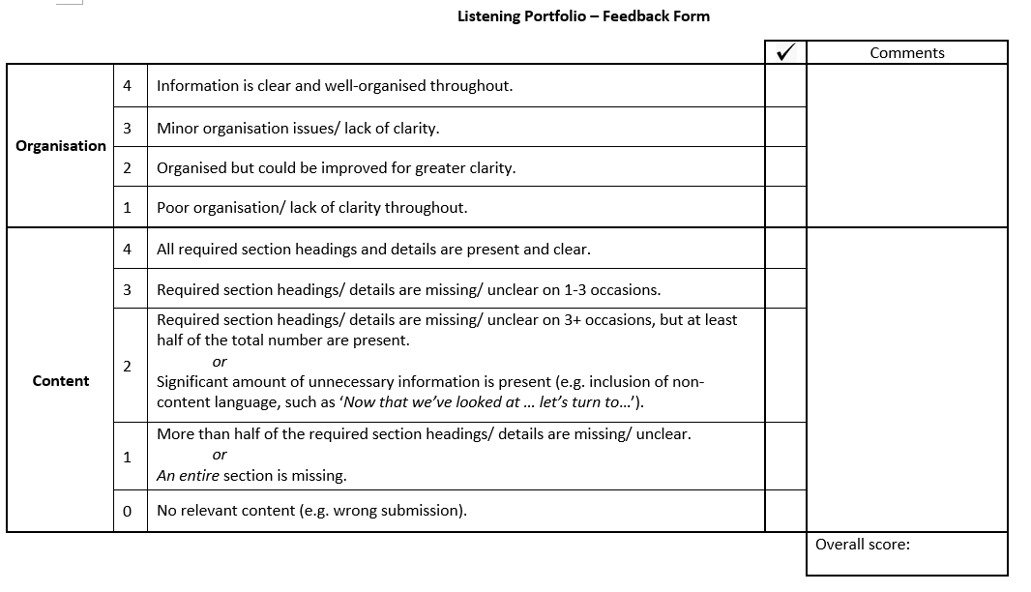
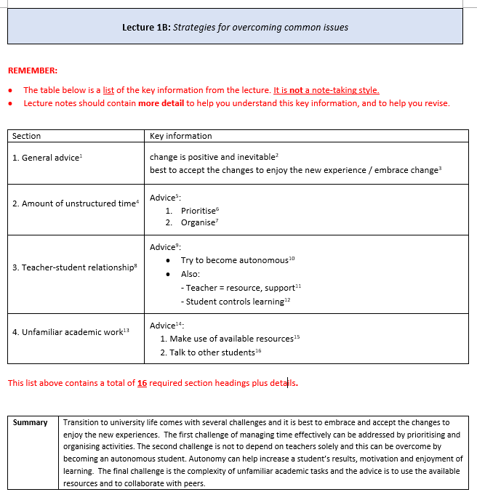
Listening Portfolio: Practice task feedback
Go to Moodle and download …
Listening Portfolio feedback form
(Assessment section)
Lecture 1B - List of required lecture information
(Week 4 section)
Then, use the feedback form to assess the notes you took for Lecture 1B.
This form will be used to assess your Listening Portfolio Tasks 1-2.

Slide 7
Listening Portfolio: Assessed tasks
The assessed Listening Portfolio tasks are very important for developing the listening ability you will need at UNNC.
Complete the work yourself - do not use another student’s notes AND do not use generative AI to assist you.
Ensure your notes are kept private - do not share them or post them on social media.
Access task videos via your own Moodle log in. Use will be monitored.
Any breaches of the above rules are considered academic misconduct and can have serious consequences.

Slide 8

Core Unit 2:
Getting started

Slide 9

Getting started
Discuss the following questions with your partner.
What is stress?
What causes you to feel stressed? Think of some specific examples.
How does your behaviour change when you feel stressed?

Slide 10

Getting started
Read each of the statements in the table. Give each one a number 1-4 according to how true it is for you.
 | 1 | 2 | 3 | 4
I feel some stress today.
University life has been stressful so far.
I am a person who feels stress more than others.
I have effective strategies for coping with stress.
I need to understand more about coping with stress.
1= not true
2= slightly true
3= true
4= very true
When you have finished, your teacher will assign different areas of the room a number 1-4. The teacher will read out each statement and you should move to the area according to the number you chose. Talk to the other students in the area and explain why you chose that number.

Slide 11

Preparing for the lecture

Slide 12


Preparing for the lecture: Vocabulary building (A)
Check your answers to the homework task.
1 | depression (n) | Depression is a mood __________ that is marked by varying degrees of __________.
2 | symptom (n) | A symptom is a __________ or __________ of an illness or disease.
3 | hormone (n) | A hormone is a chemical released by cells in the body that has a __________ or __________ effect.
4 | response (n) | A response is a __________ or __________ to something.
5 | chronic (adj) | Chronic means occurring __________ and/or for a __________.
6 | detrimental (adj) | Detrimental means having a __________ or __________ effect.
7 | associate (v) | Associate means to __________ or ____________ things together, usually __________.
8 | maxim (n) | A maxim is a general __________ or fundamental __________.
9 | prevention (n) | Prevention is the act of __________ or __________ something from happening.
10 | alleviate (v) | Alleviate means to make something less __________, difficult, or __________.
Depression is a mood disorder that is marked by varying degrees of sadness.
A symptom is a sign or evidence of an illness or disease.
A hormone is a chemical released by cells in the body that has a physical or emotional effect.
A response is a reply or reaction to something.
Chronic means occurring repeatedly and/or for a long time.
Detrimental means having a negative or damaging effect.
Associate means to join or connect things together, usually mentally.
A maxim is a general truth or fundamental principle.
Prevention is the act of stopping or hindering something from happening.
Alleviate means to make something less painful, difficult, or severe.

Slide 13
Preparing for the lecture: Vocabulary building (B-C)
B. Check your answers to the homework task.
C. Read the sentences out loud and see if your partner agrees or disagrees with each statement.
 |  | Partner response
1 | More (depression / from / people / suffer) in winter than in summer.
 | More people suffer from depression in winter than in summer.
2 | A bad stomach (of / symptom / be / a / stress / can).
 | A bad stomach can be a symptom of stress.
3 | Anger is sometimes (stress / response / reasonable / to / a).
 | Anger is sometimes a reasonable response to stress.
4 | Stress (always / performance / is / detrimental / to).
 | Stress is always detrimental to performance.
5 | It is (stress / associate / to / reasonable / with) modern technology.
 | It is reasonable to associate stress with modern technology.
6 | Eating a low-calorie diet (effective / is / to / way / an / stress / alleviate).
 | Eating a low-calorie diet is an effective way to alleviate stress.

Slide 14
Preparing for the lecture: Listening and note-taking focus
Recognising transitions in a lecture
In Core Unit 1, we talked about how a good lecture is divided into sections to help the listener. There is usually a preview of these sections in the introduction, and a review in the conclusion. It is important to follow the structure while you are listening, and so it is useful to recognise when one section finishes and another section starts. This change is known as a transition.
There are three indicators of a transition:
Signposting phrases (e.g. I’d like to move on to)
Signposting words (e.g. OK… I’d like to move on to)
Pronunciation clues (e.g. intonation change ↑↓ and pausing / )

Slide 15
Preparing for the lecture: Listening and note-taking focus
A student has been asked to give a 1-minute speech about stress in her life. Listen and use the transcript to:
Underline transition signposting phrases
Circle or highlight transition signposting words
Mark intonation changes (↑↓) and pauses (/)
So… I’ve been asked to talk about stress in my life. OK, I’ll begin by saying that I think my stress is pretty well under control- it’s not chronic for sure. But, that’s not because I don’t feel stress in certain situations- I think it’s more because I manage it quite well. Right, turning to the biggest cause of stress for me- I’d say it’s the expectations of my parents. They push me pretty hard sometimes. This is generally a good thing, but sometimes it can also be detrimental. Now then, I’ve talked about a cause, and I’ll now discuss how I alleviate it. Well, I love music. I associate certain songs with happy times. So if I feel stress, then listening to those songs really helps. That’s it. Thank you.

Slide 16

Listening to the lecture

Slide 17
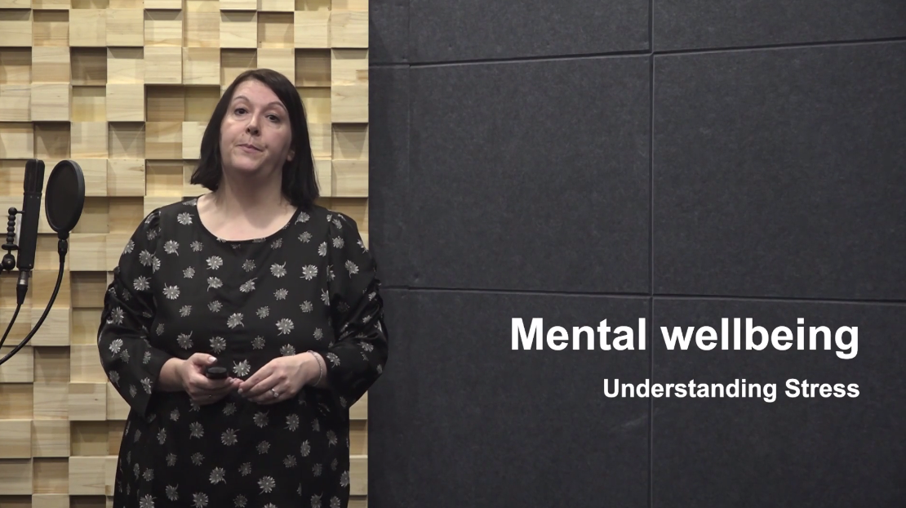
Listening to the lecture: Lecture content focus
You are going to watch Lecture 2A ‘Understanding stress’. The lecturer will discuss four ways to alleviate stress.
Before watching the lecture, brainstorm some ways to alleviate stress that you think might be mentioned in the lecture.

Slide 18
Listening to the lecture: Listening
Watch Lecture 2A ‘Understanding stress’ and take notes as you listen.

Slide 19
Listening to the lecture: Comprehension check - Main ideas
Use your notes to help you decide if the statements below are T (True), or F (False), based on the lecture. Correct any false statements.
a. Chronic stress can be positive in certain situations. | F
b. Symptoms of stress can appear in the mind, the way we act and how we feel physically. | T
c. Stress is usually caused by internal factors, which are things related to the individual character of a person. | F
d. External factors relating to academic study can be a major cause of stress. | T
e. The best way to deal with stress is to cure it with medicines or therapy. | F
f. Time management is suggested as a way to control stress before it becomes serious. | T
lead to health problems. (short-term stress can be useful)
can be
(external factors are more likely causes)
prevent it.

Slide 20
Listening to the lecture: Comprehension check - Details
Work with a partner. Take turns to choose a number from the table below for your partner. When your partner gives you a number, make sentences based on information from the lecture. Check the box on the right when each number is complete.
1 | a definition of stress
2 | one example of mental symptoms of stress
3 | one example of behavioural symptoms of stress
4 | one example of physical symptoms of stress
5 | one example of internal factors leading to stress
6 | one example of external factors leading to stress
7 | the first way to alleviate stress
8 | the second way to alleviate stress
9 | the third way to alleviate stress
10 | the fourth way to alleviate stress

Slide 21
Listening to the lecture: Comprehension check - Details
Suggested sentences:
Stress is the body’s way of dealing with dangerous situations.
One example of mental symptoms of stress is worrying/ being overwhelmed/ difficulty concentrating/ forgetfulness.
One example of behavioural symptoms of stress is not sleeping/ not eating well/ being less patient/ avoiding people.
One example of physical symptoms of stress is headaches/ muscle tension/ having an upset stomach/ being sick.
One example of internal factors leading to stress is focusing on negative news/ having unrealistic expectations.
One example of external factors leading to stress is amount of work/ fear of failing/ certain assignment types.
The first way to alleviate stress is exercise (2-3 sessions of vigorous exercise a week).
The second way to alleviate stress is talking to people (other students or people at home).
The third way to alleviate stress is time management (prioritise and organise time).
The fourth way to alleviate stress is getting enough sleep (wind down before sleep).

Slide 22

Developing the topic

Slide 23

Developing the topic
In addition to the advice given in the lecture, it is important to be aware of the support services available to you at UNNC. For homework, you looked at the webpage for UNNC’s Health and Wellbeing Centre.
Discuss the following questions in your groups.
How does the centre relate to today’s topic and the ideas in the lecture?
How do the services available contribute to the university’s EDI principles?
How can we encourage students to use these services when they need them?

Slide 24




Developing the topic
Person A
Person B
Person C
Person D
In your group, create a story for one of the people in the photographs using the questions on the right to help you.
Stand up and talk to 2 other people. Tell them about your person’s situation. When you listen to others, ask questions and provide advice based on information from today’s lesson.
When you have finished, report back to your group. What was the most useful piece of advice for your person?
Who is (s)he?
Why is (s)he stressed?
(be detailed about the situation and cause)
What are his/ her symptoms?

Slide 25
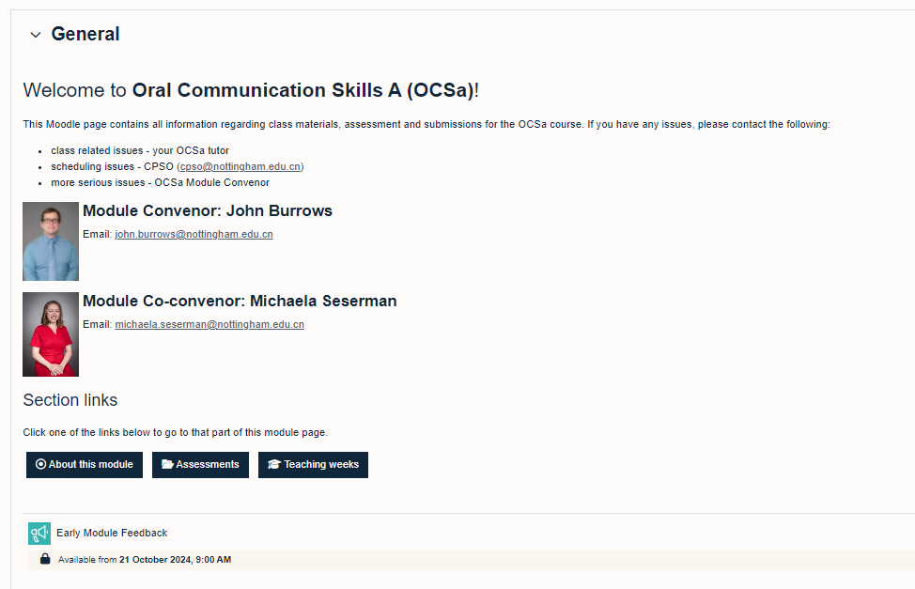
Early Module Feedback (EMF)
Student feedback is important to continuously improve teaching and learning here at UNNC.
Please share your first impressions about this module.
Survey opens on Monday 21st Oct and closes on Sunday 27th Oct.

Slide 26
Homework
Due | Task
Lesson 4.2 | Watch the YouTube video ‘How does your diet impact mental health?’ and write down the main ideas. You can find the link to the video on the OCSa Moodle page, in the Week 4 section. N.B. You should be connected to eduroam wifi to watch the video.
Monday, 28th October 3pm | Listening Portfolio - Task 1 (assessed) Watch Lecture 2B: Technology and mental health and take notes. Submit a copy of your notes via the submission box on the OCSa Moodle page before the Monday deadline.

Slide 27

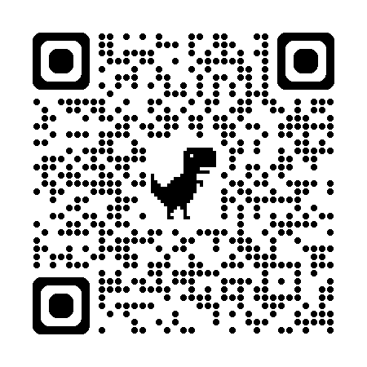
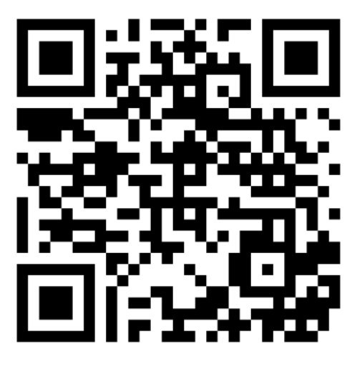
Week 4
Extra resources for OCSa this week on the Writing Lab Moodle page:
Listening → Lecture listening
Note-taking → Lecture note-taking
Next week (Week 5 – beginning 28th of October):
Utalk continues! Your opportunity to practice group
discussion in a relaxed and supportive environment.
PB 115, 1:00pm – 1:50pm
Yang Fujia Building, 6:00pm – 6:50pm.
Days vary.
Sign-up using the SPDPO credit system.
Centre for English Language Education CELE N048 AY 24-25

Slide 28
Oral Communication Skills A
(CELEN069)
Lesson 4.2

Slide 29
Lesson aims and objectives
By the end of this lesson, you should have enhanced your speaking and listening ability through practice.
In addition, you should be better able to … | Intended Learning Outcomes
interact in a discussion by asking a range of different types of questions | 1.1-1.6 2.1 2.6
use appropriate language to ask a range of different types of questions

Slide 30
Getting started

Slide 31

Getting started
Think of a positive habit that could be from your life now or from a time in the past.
This could be true or false!
During the summer, I exercised everyday.
Work in your group.
When it’s your turn, share your habit.
Each student from the group should ask one follow-up question*, then guess if the habit is true or false.
What kind of exercise did you do?
How long did you exercise for?
*Follow-up questions seek to obtain more information about something.
What…?
How…?
Why…?
Where…?
When…?
Who…?

Slide 32

Language and skills
focus

Slide 33

Language and skills focus: Asking questions
A good interviewer will ask questions to make sure information is clear and to allow the interviewee to develop answers that are interesting or useful. This is also necessary in a group discussion. Asking questions of others allows a discussion to be interactive, which is very important. These questions ensure that the discussion develops naturally, and that the speaker’s message is understood correctly.

Slide 34
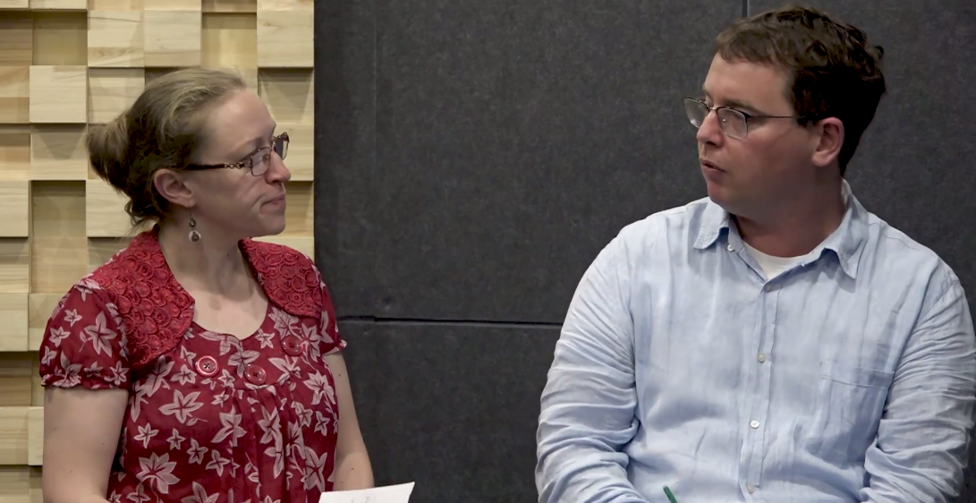
Language and skills focus: Asking questions
You are going to watch a short interview about positive mental health habits.
As you listen, make a note of the main ideas missing from the notes below.
Self-awareness
thinking about emotions
observing physical/ emotional reactions
e.g. tired today → try to identify causes: food? sleep? stress?
Exercise
Cardio
gets heart pumping; stamina & energy ↑
jogging and running
Strength
strengthen muscles, release endorphins
Michaela
John

Slide 35
Language and skills focus: Asking questions
Look at the partial transcript and try to figure out the questions using your memory and the answer stems given. Then watch the interview again and complete the answers.
Michaela: I tend to focus on exercise and self-awareness.
John: OK, so self-awareness: Could you tell me what you mean by that?
Michaela: So self-awareness basically refers to…
John: OK, could you give me an example of what you do?
Michaela: So, for example let's say today I'm feeling…
John: OK, I got it. OK, so that's self-awareness, now, sorry, could you remind me what was the other method that you talked about?
Michaela: So the other method is exercise.
John: Ah OK, exercise, so could you elaborate on that a little bit?
Michaela: OK, so I tend to focus on alternating between cardio and strength exercise.
John: Ok, so cardio. What do you mean by cardio?
Michaela: Cardio is any type of exercise that would get your heart pumping…
John: OK could you be a bit more specific in terms of exercises that you do?
Michaela: Jogging and running are the best types of cardio…
1.
2.
3.
4.
5.
6.
Michaela
John

Slide 36
Language and skills focus: Asking questions
The interview mainly contains two types of question: questions for clarification and questions for elaboration.
Work with a partner. Put the questions from the previous task into the table below.
Questions for clarification seek to make things clear.
Questions for elaboration seek to gain more information.
Could you tell me what you mean by that? Could you give me an example of …? Could you remind me …? Could you elaborate on that a little bit? What do you mean by …? Could you be a bit more specific in terms of …?
Questions for clarification | Questions for elaboration
Could you tell me what you mean by that? | Could you give me an example of …?
Could you remind me …? | Could you elaborate on that a little bit?
What do you mean by …? | Could you be a bit more specific in terms of …?

Slide 37
Language and skills focus: Asking questions
Questions for clarification seek to make things clear.
Questions for elaboration seek to gain more information.
Can you think of other questions to put in the table?
Questions for clarification | Questions for elaboration
Could you tell me what you mean by that? | Could you give me an example of …?
Could you remind me …? | Could you elaborate on that a little bit?
What do you mean by …? | Could you be a bit more specific in terms of …?
Could you clarify … ? | Can you tell me more about…?
Could you repeat that? | Could you explain that further?

Slide 38
Discussion focus

Slide 39
Discussion focus: Prepare
In Lecture 2A, you heard about habits that could help alleviate stress, and therefore create positive mental health. Also, for homework you watched a YouTube video about the impact of diet on mental health. You may have also already watched Lecture 2B.
Tell your partner about one positive mental health habit from the video(s) that applies to you or that you found interesting.
When you are listening to your partner, ask follow-up questions, questions for clarification and questions for elaboration. Ask your partner at least three questions.
Questions for clarification (make things clear) | Questions for elaboration (gain more information)
Could you tell me what you mean by that? | Could you give me an example of …?
Could you remind me …? | Could you elaborate on that a little bit?
What do you mean by …? | Could you be a bit more specific in terms of …?
Could you clarify … ? | Can you tell me more about…?
Could you repeat that? | Could you explain that further?

Slide 40
Discussion focus: Discuss
In small groups, have a discussion based on the prompt below.
Make sure that you use all the time and that everybody has a chance to give and support their opinions.
What are some major causes of mental health issues for university students?
What are the three most effective ways of managing these issues?

Slide 41
Discussion focus: Reflect
Reflect on your group discussion and answer the questions below.
 |  | Yes | Partly | No
My group | We used all the time
 | We answered the questions on the prompt
 | All the content was relevant
 | Everybody had a chance to contribute
Me | I gave and supported my opinions
 | I asked others for their opinions
 | I asked questions that allowed others to clarify or develop their answers
1 or 2 things I did well…
1 or 2 things I could do better in the next discussion…

Slide 42
Early Module Feedback (EMF)
Student feedback is important to continuously improve teaching and learning here at UNNC.
Please share your first impressions about this module.
Survey opens on Monday 21st Oct and closes on Sunday 27th Oct.

Slide 43
Homework
Due | Task
Monday, 28th October 3pm | Listening Portfolio - Task 1 (assessed) Watch Lecture 2B: Technology and mental health and take notes. Submit a copy of your notes via the submission box on the OCSa Moodle page before the Monday deadline.
Lesson 5.1 | Complete the ‘Language learner profile survey’ (Class Workbook - end of Lesson 5.1). You will need that information for one of the class activities. Complete ‘Vocabulary building’ tasks A & B (Class Workbook - Lesson 5.1 ).
Self-study
Check out the self-study materials on the OCSa Moodle page for this week: vocab review, reading more on the topic, additional listening practice.

